Slide 1
Density Functional Theory(DFT) based ab-initio computations of Graphene and its various point defects

Slide 2
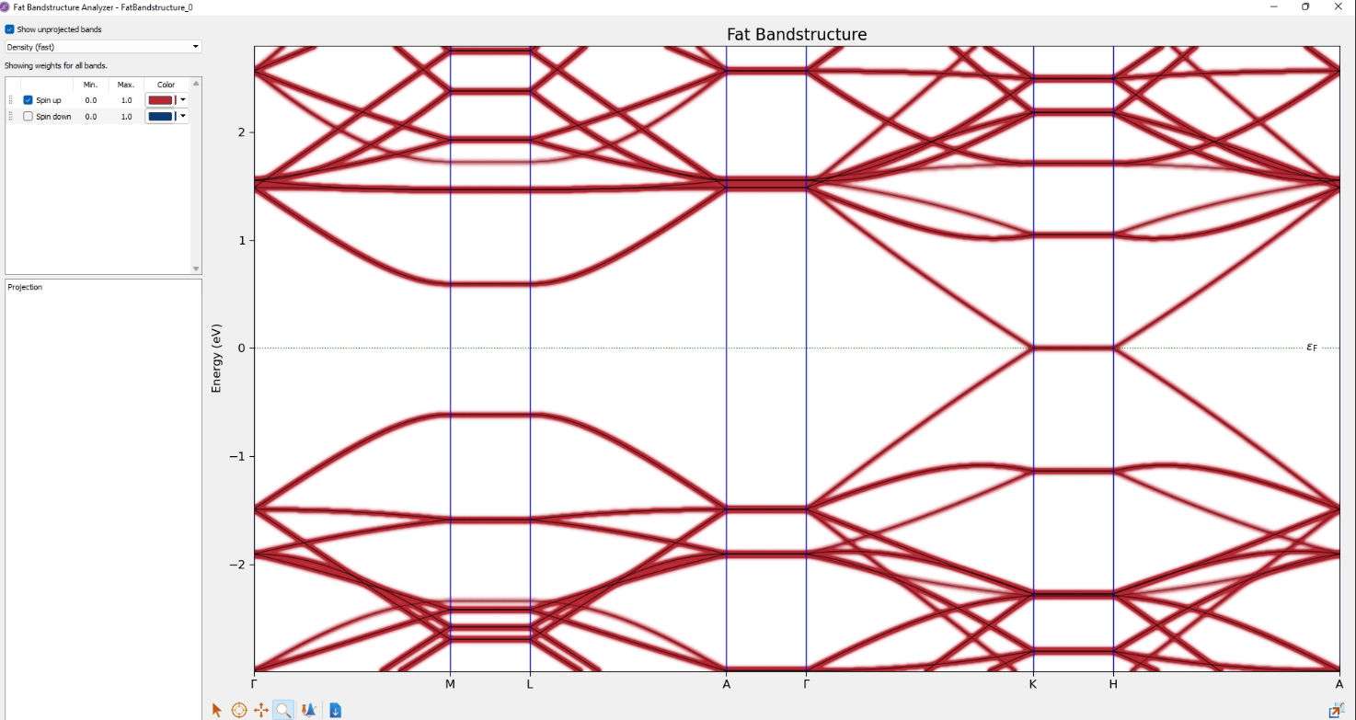
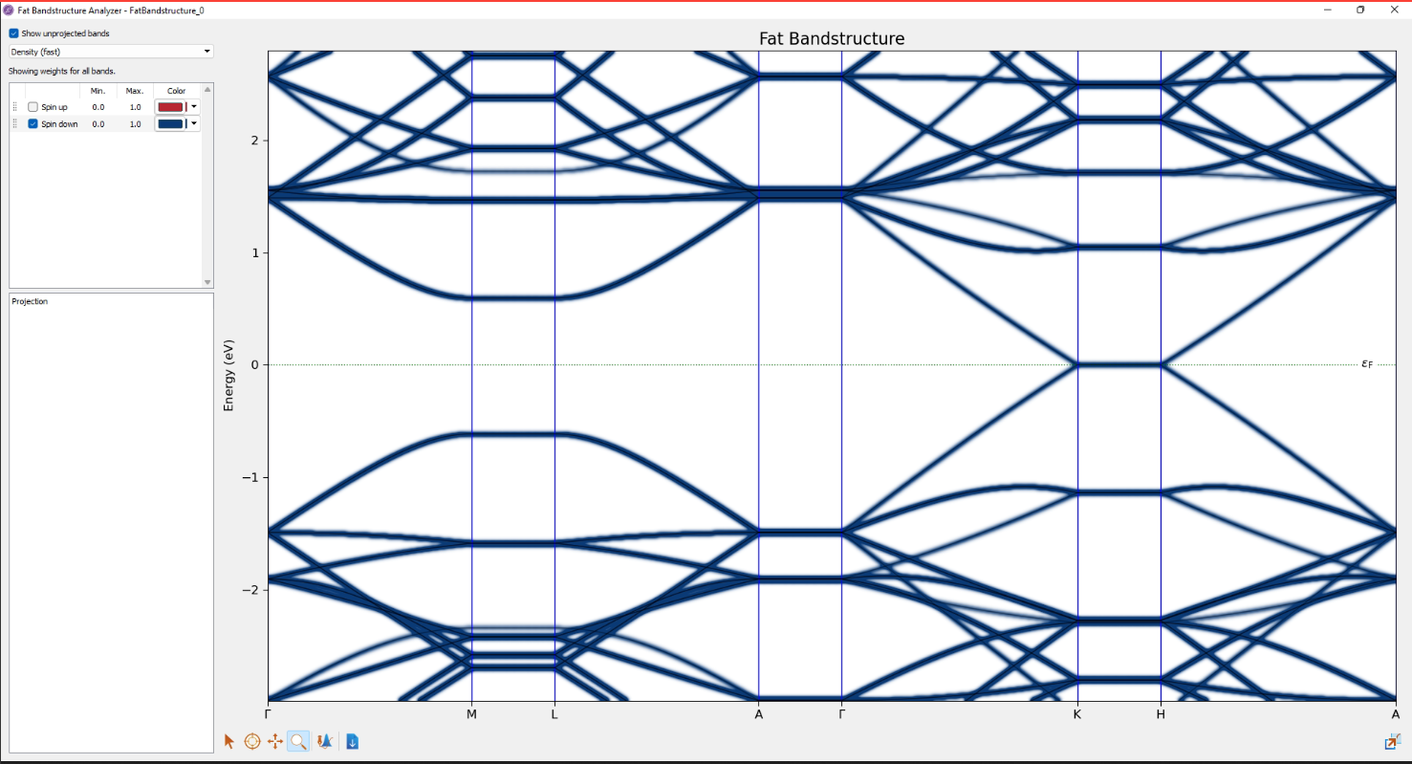
CONTRIBUTION OF SPIN UP AND SPIN DOWN ELECTRONS IN BAND STRUCTURE OF PRISTINE GRAPHENE
These fat band structures represent contribution of spin up and spin down electrons.
As the shaded regions due to the up spin and the down spin electrons are equivalent we can conclude from here that both spin up and spin down electrons have the same contribution in the energy band.

Slide 3
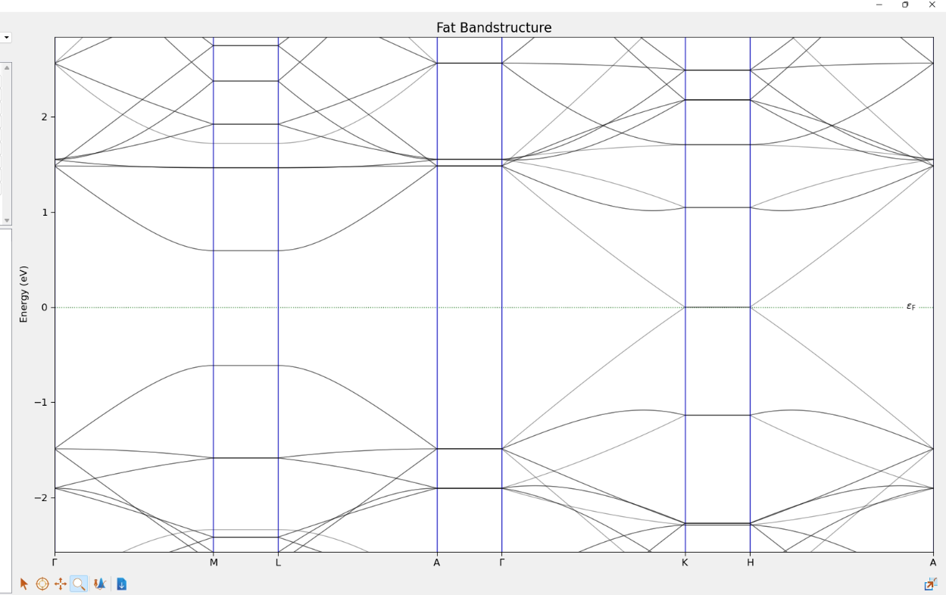
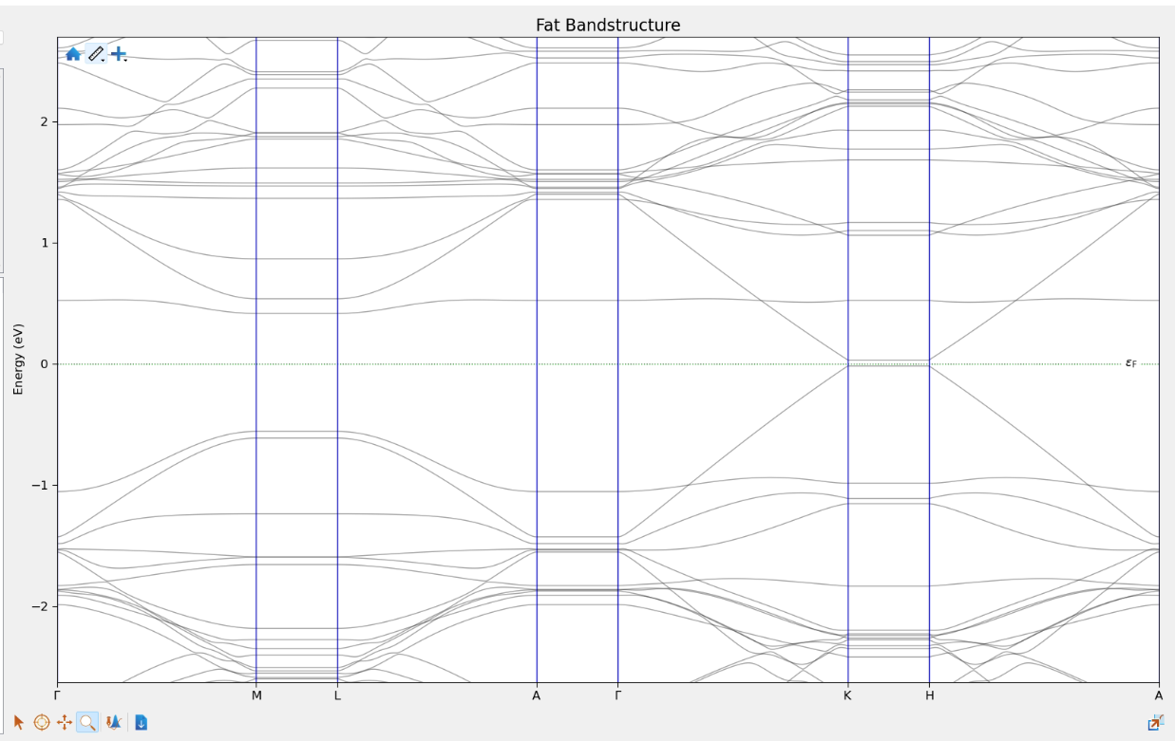
COMPARISION OF FAT BAND STRUCTURES
Pristine
Introducing a Stone Wales defect in graphene opens a band gap.
There are new energy bands appearing, splitting the maxima from the valence band and minima from the conduction band.
Stone Wales defect

Slide 4
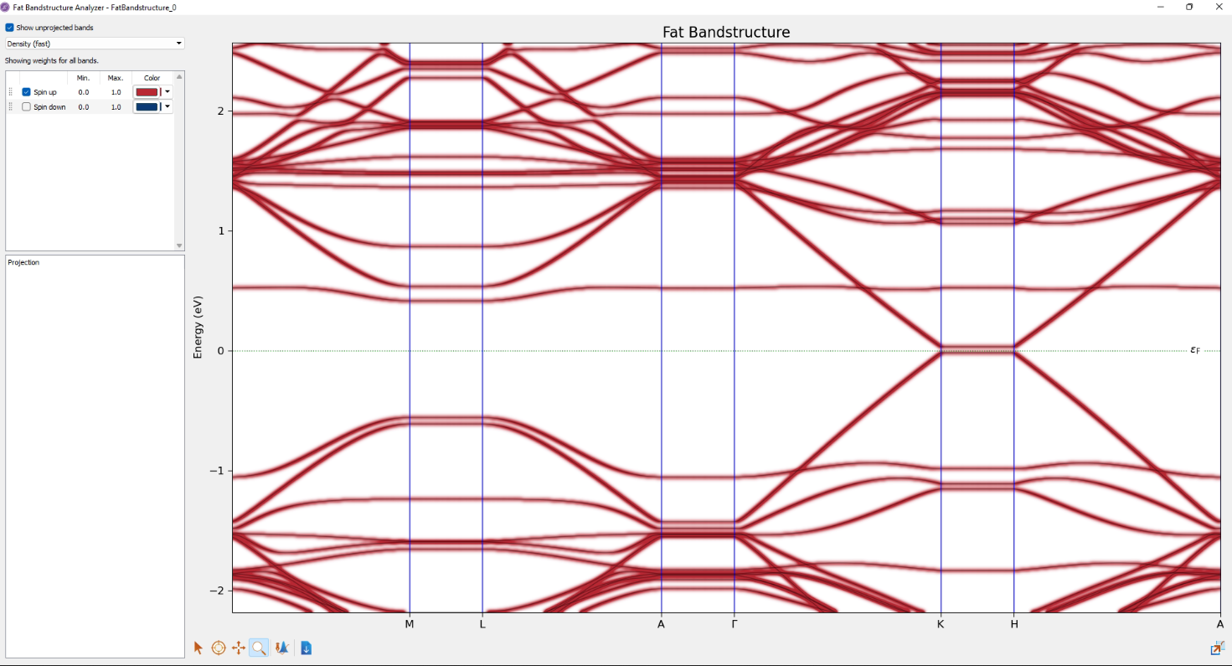
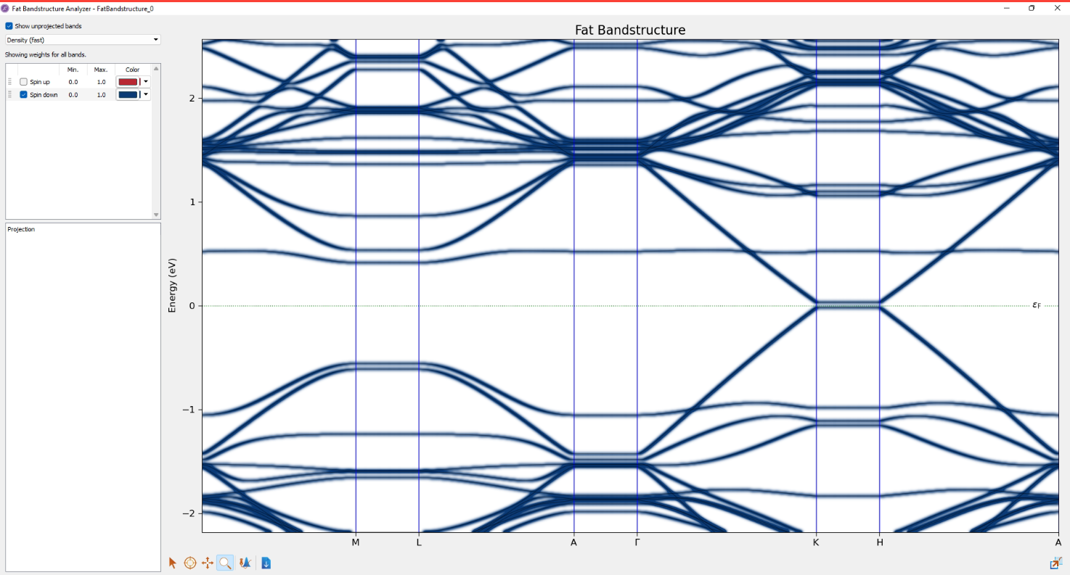
CONTRIBUTION OF SPIN UP AND SPIN DOWN ELECTRONS IN BAND STRUCTURE OF GRAPHENE WITH STONE WALES DEFECT
These graphs above demonstrate the contribution of spin up and spin down electrons in the case of graphene with Stone Wales defect.
As the shaded region appear exactly the same ,we can conclude from here that the contribution of spin up and spin down electrons in this case is the same.

Slide 5
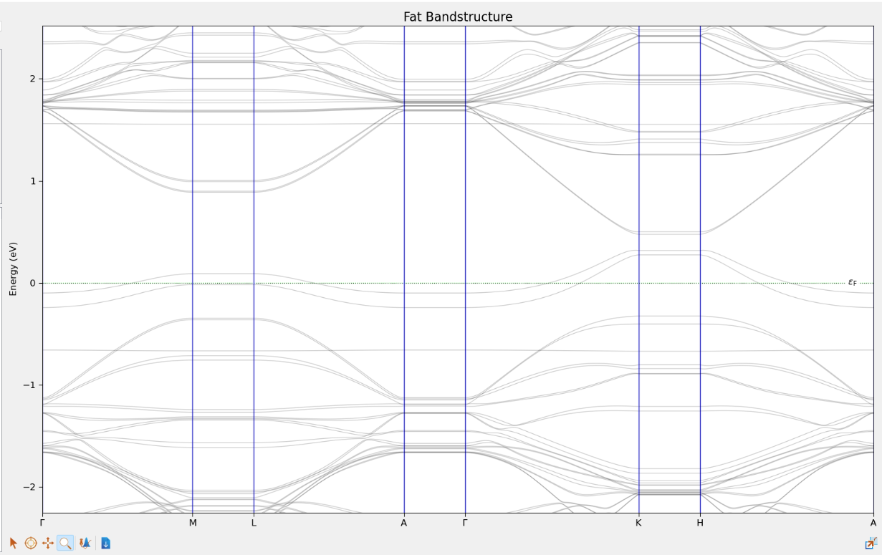
Two new energy bands appear near the Fermi level which changes the value of maxima of the valence band.
It basically separates the valence band and the valence band maxima.
The maxima of the valence band rises above the fermi level.
The vacancy defect opens a band gap unlike the case of Pristine Graphene.
Pristine
Vacancy Defect

Slide 6
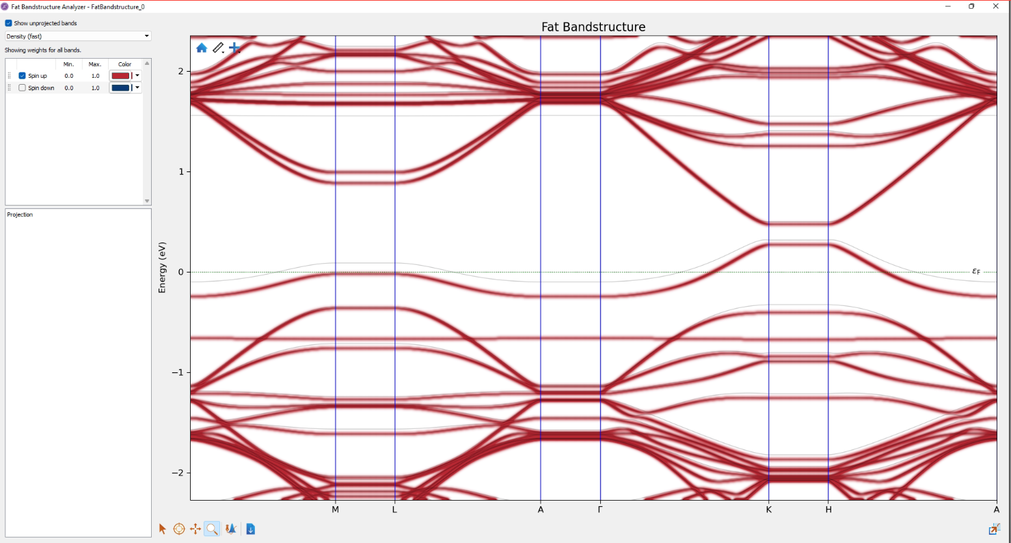
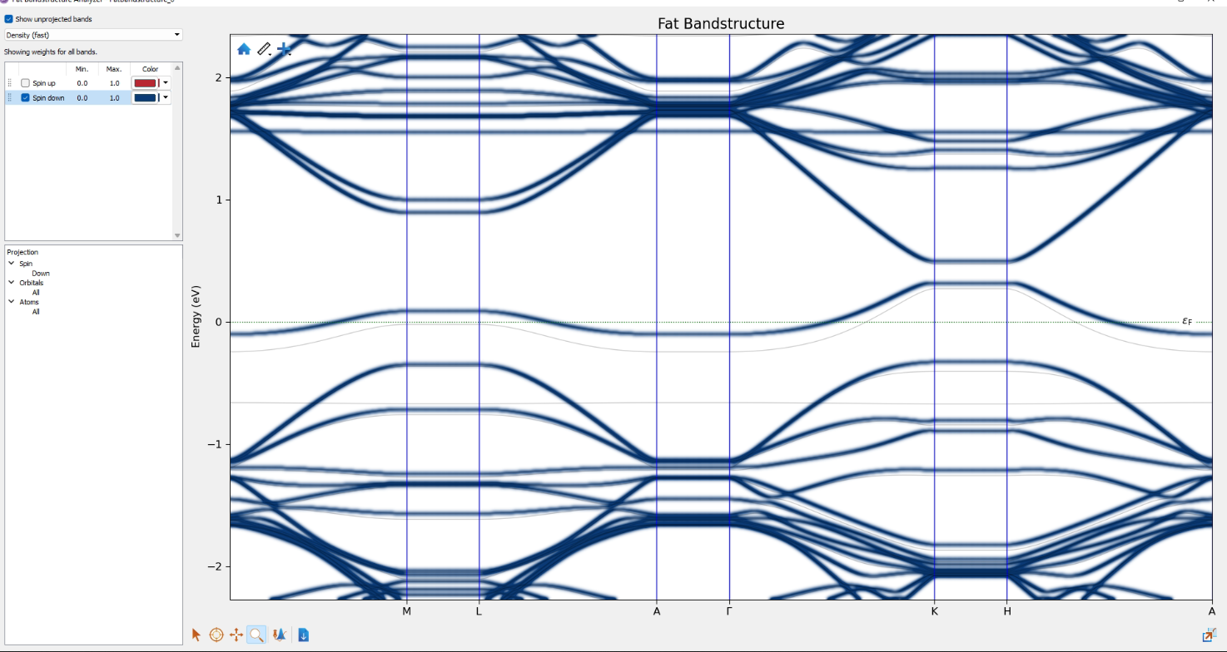
CONTRIBUTION OF SPIN UP AND SPIN DOWN ELECTRONS IN BAND STRUCTURE OF GRAPHENE WITH VACANCY DEFECT
These fat band structures represent the contribution of spin up and spin down electrons on Graphene with a carbon vacancy.
On the introduction of a carbon vacancy in Graphene we had observed that two new energy levels emerged near the fermi level.
From the graphs above, it can be observed that out of the two new energy levels, one was the contribution of spin up electrons while the other was due to spin down electron.

Slide 7
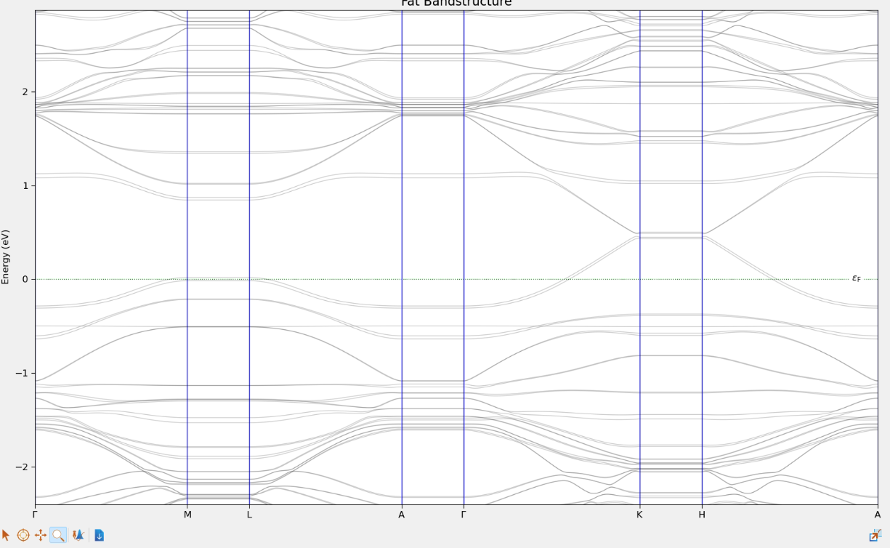
Pristine
Vacancy and Stone Wales
Introduction of both Stone Wales defect and carbon vacancy defect opens a band gap as in the previous cases.
New energy bands emerge separating the maxima of the valence band and minima of the conduction band.
The maxima of the valence band rises above the fermi level.

Slide 8
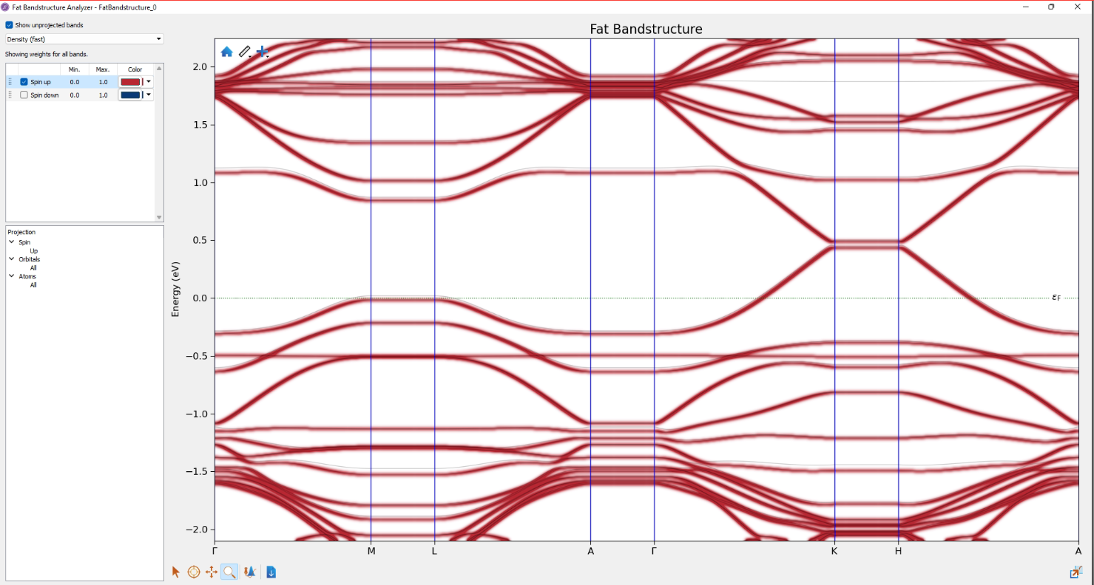
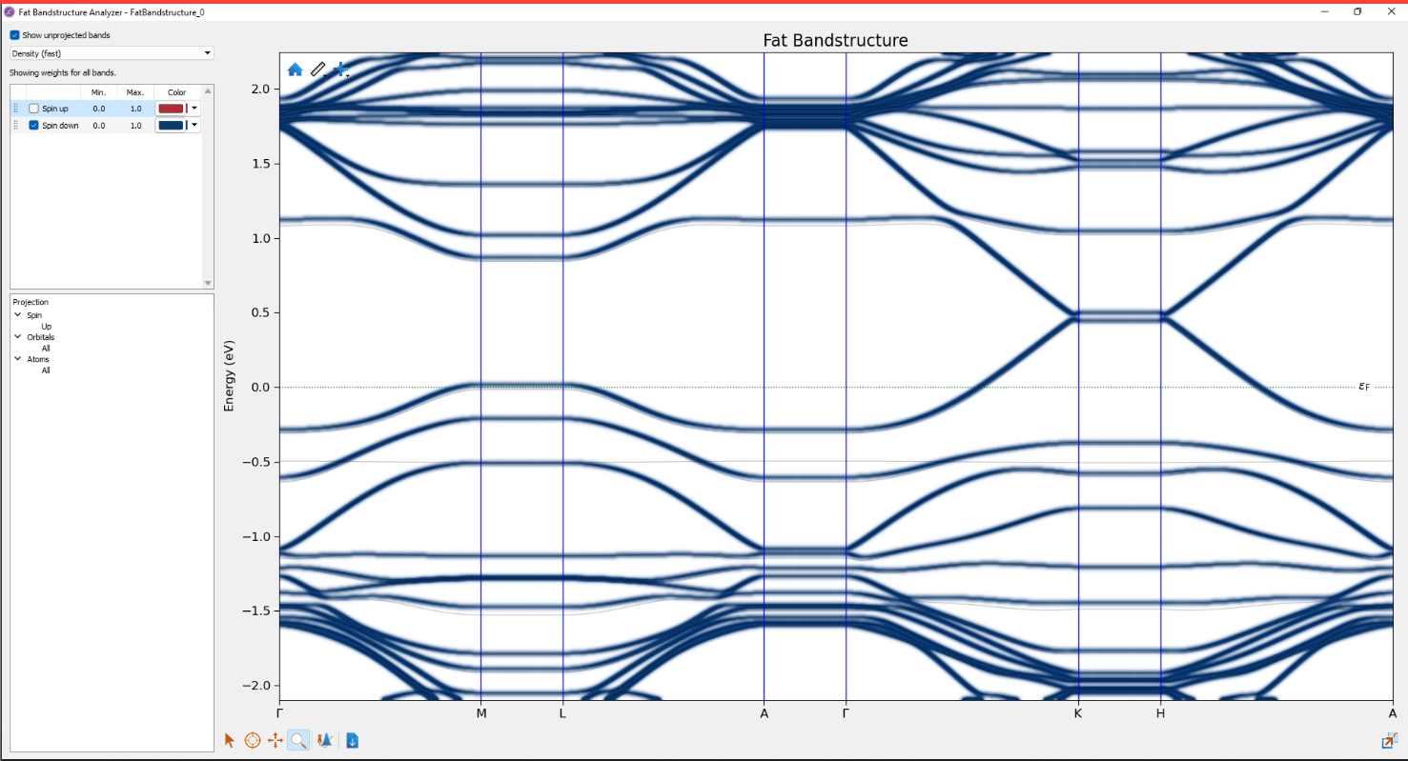
CONTRIBUTION OF SPIN UP AND SPIN DOWN ELECTRONS IN BAND STRUCTURE OF GRAPHENE WITH VACANCY DEFECT AND STONE WALES DEFECT
The graphs depict the contribution of spin up and spin down electrons in the case of graphene with both stone Wales defect and carbon vacancy defects.
In the valence band, due to the introduction of defects two new energy bands were created splitting the maxima of the valence band.
Out of the two new valence band created, the one situated above or the one with the higher energy is a contribution of the spin down electrons.
In the conduction and, due to the introduction of defects two new energy bands were created here as well.
The one which is situated below or the one with the lower energy than the other is a contribution of spin up electrons.

Slide 9
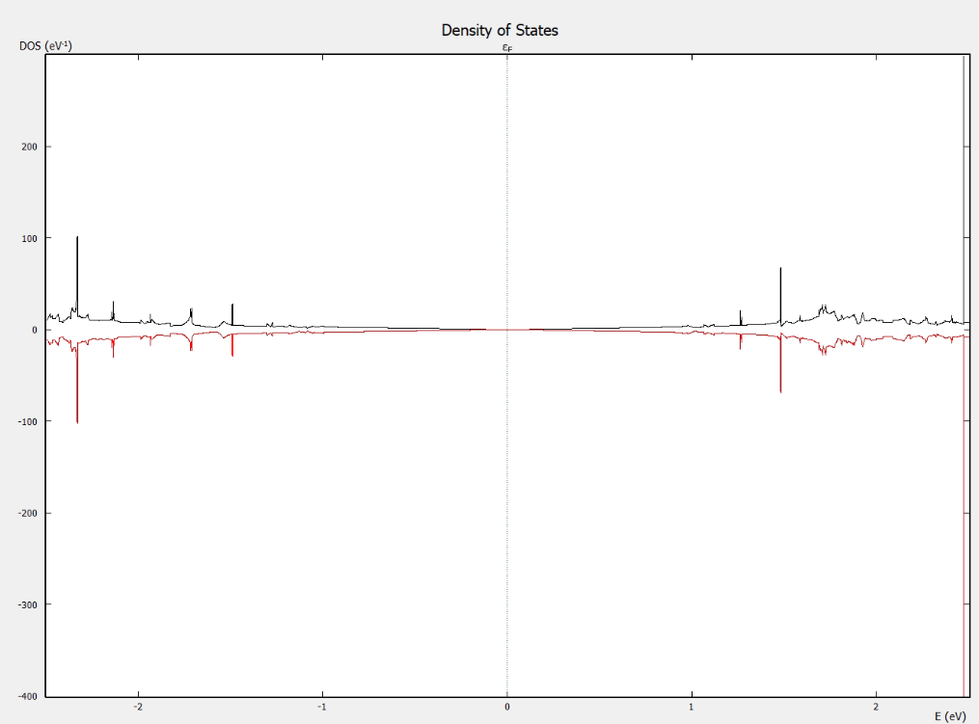
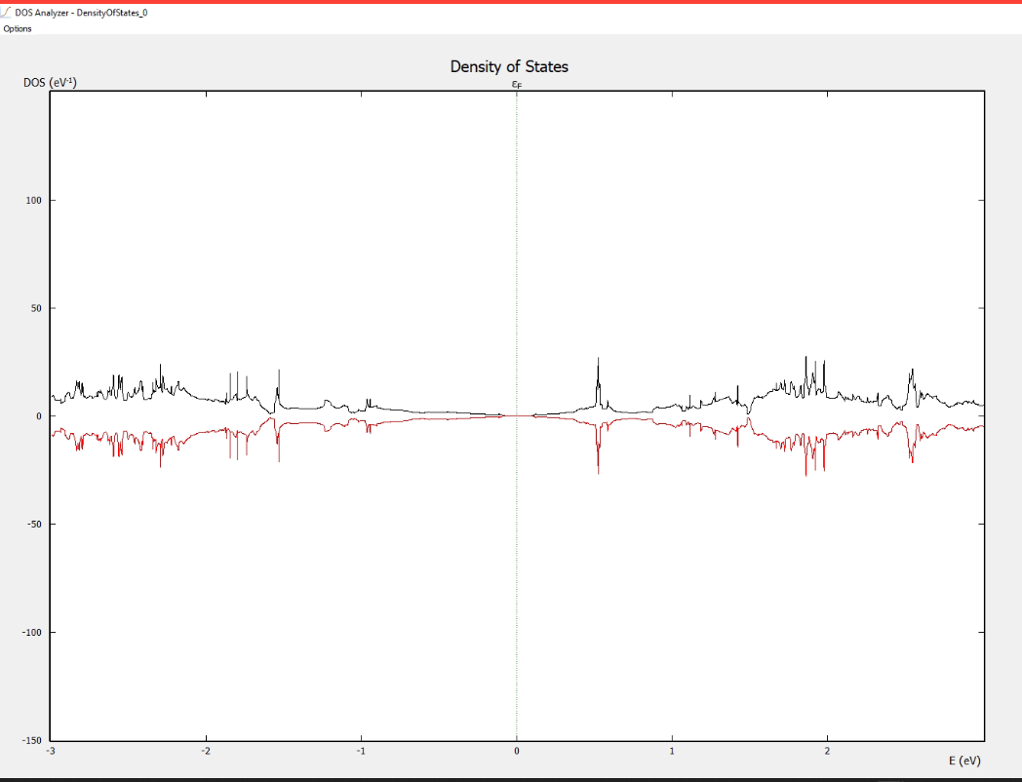
COMPARISION OF DENSITY OF STATES OF PRISTINE GRAPHENE AND GRAPHENE WITH STONE WALES DEFECT
The above graphs show the plot of density of states for pristine graphene and graphene with stone wales defect.
At the region near the fermi level, new states are created in graphene with the stone wales defect when compared to pristine graphene, specifically in the regions from 0 eV to 1.5 eV on both sides in the case of pristine graphene, not much significant states could be observed while in graphene with stone wales defect, even in this region there are states present to accommodate the electrons.
Another thing that could be noted is that the DOS plot for the stone wales defect is symmetric for spin up and spin electrons resulting to a zero magnetic moment.

Slide 10
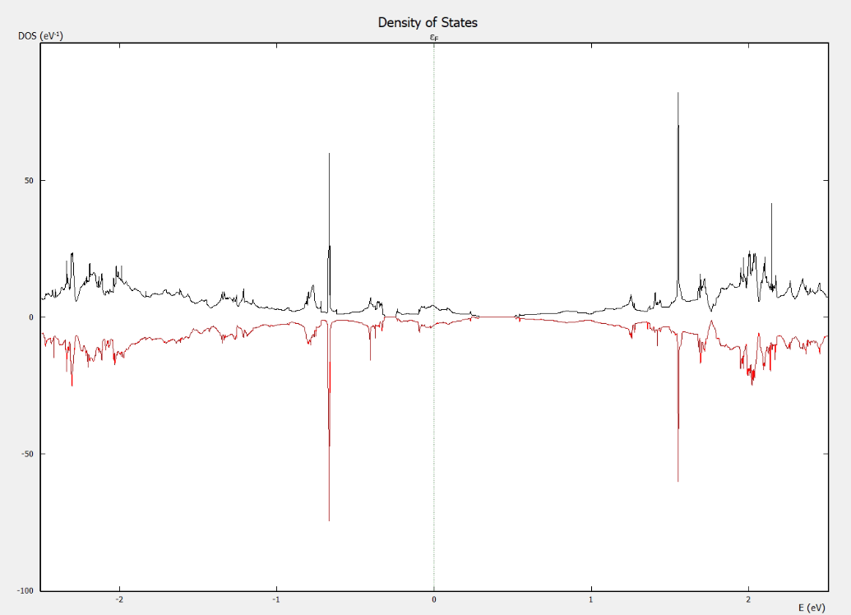
COMPARISION OF DENSITY OF STATES OF PRISTINE GRAPHENE AND GRAPHENE WITH VACANCY DEFECT
The graph above is the plot of DOS and the contribution of spin up and spin down electrons in DOS.
Unlike in the case of pristine graphene, the introduction of vacancy in graphene creates states in the regions near to the fermi level.
In the valence band between 0eV to 1eV, the spin down electrons has more contribution than the spin up electrons as the DOS has a greater dip in spin down than in spin up.
In the conduction band between 1eV to 2eV, the spin up electron has more of a contribution in DOS than in the spin down as it has a greater peak.
The DOS is not symmetric in the case of vancy induced graphene which causes a magnetic moment.

Slide 11
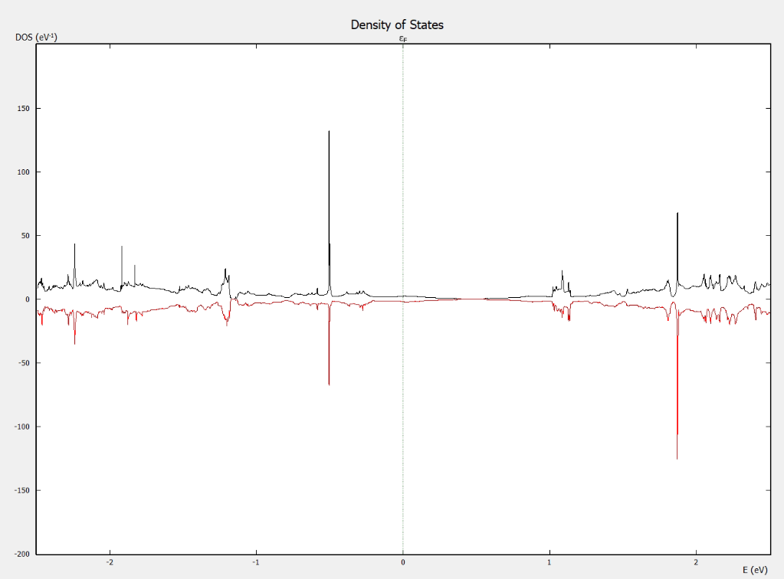
COMPARISION OF DENSITY OF STATES OF PRISTINE GRAPHENE AND GRAPHENE WITH STONE WALES DEFECT AND VACANCY DEFECT
The above plot shows the DOS of pristine graphene and graphene with both stone wales defect as well as carbon vacancy defect.
There are states introduced near the fermi level, which is more significant in the valence band side.
In the valence band at near 0.5eV, the contribution of spin up electron is more than that of spin down electron.
In the conduction band, the region near to 2eV, the contribution of spin down electron is more than that of spin up electron.
The DOS is not symmetrical about the spin up and spin down regions hence we can conclude that it has a magnetic moment.

Slide 12
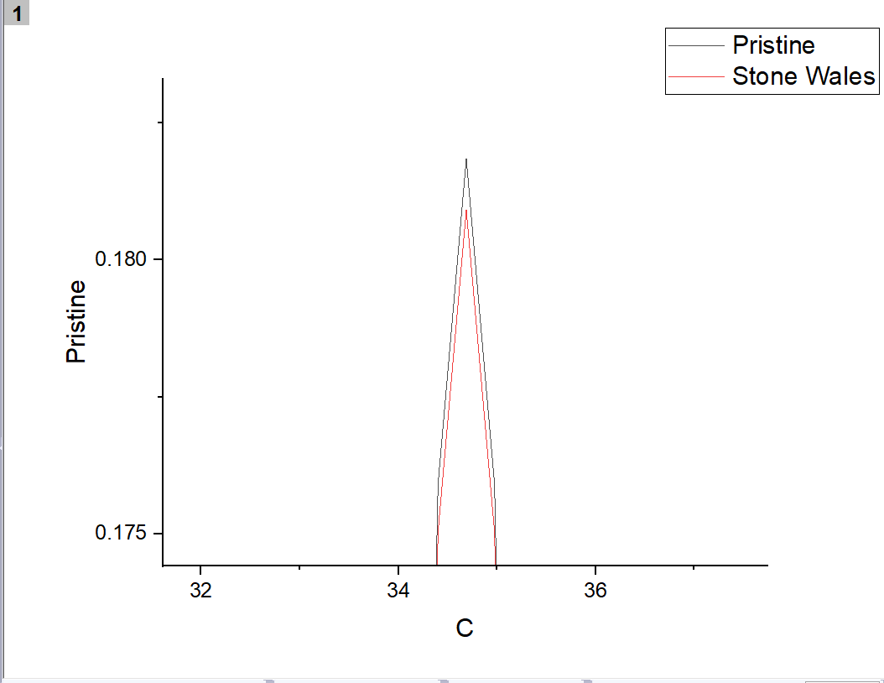
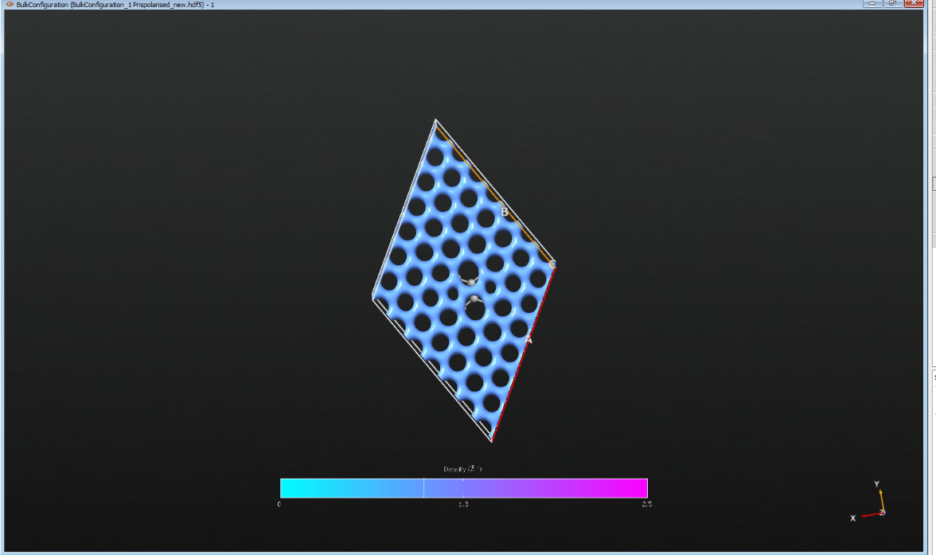
COMPARISION OF ELECTRON DENSITIES OF PRISTINE GRAPHENE AND GRAPHENE WITH STONE WALES DEFECT
The graph above compares the electron density of pristine graphene and graphene with a stone wales defect.
The peak for pristine is higher than that of graphene with the stone wales defect.
Due to the defect the electron density gets disturbed around the region of the defect hence the graph.

Slide 13
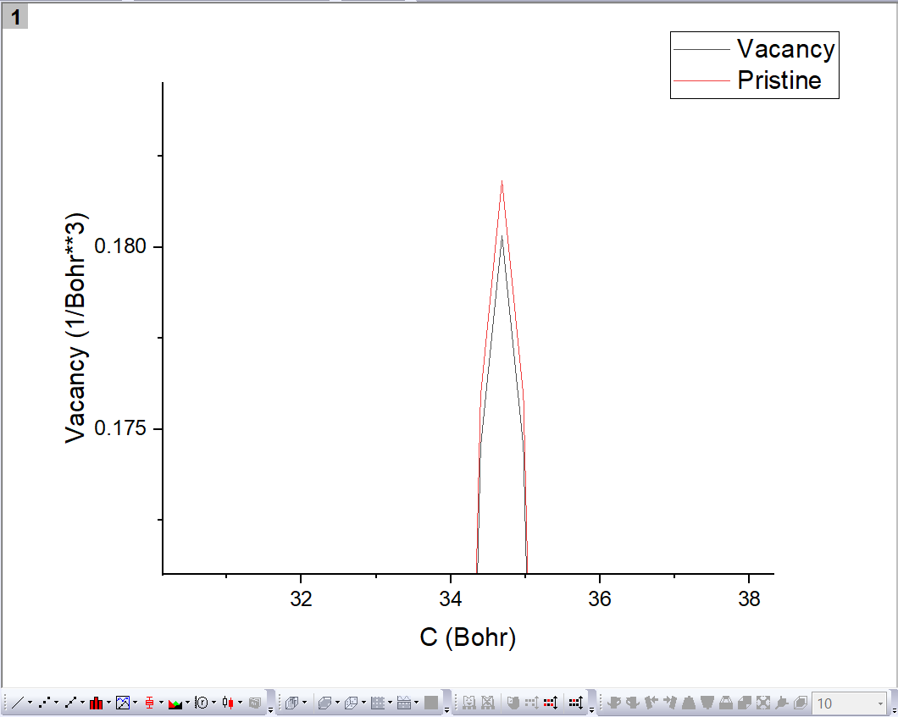
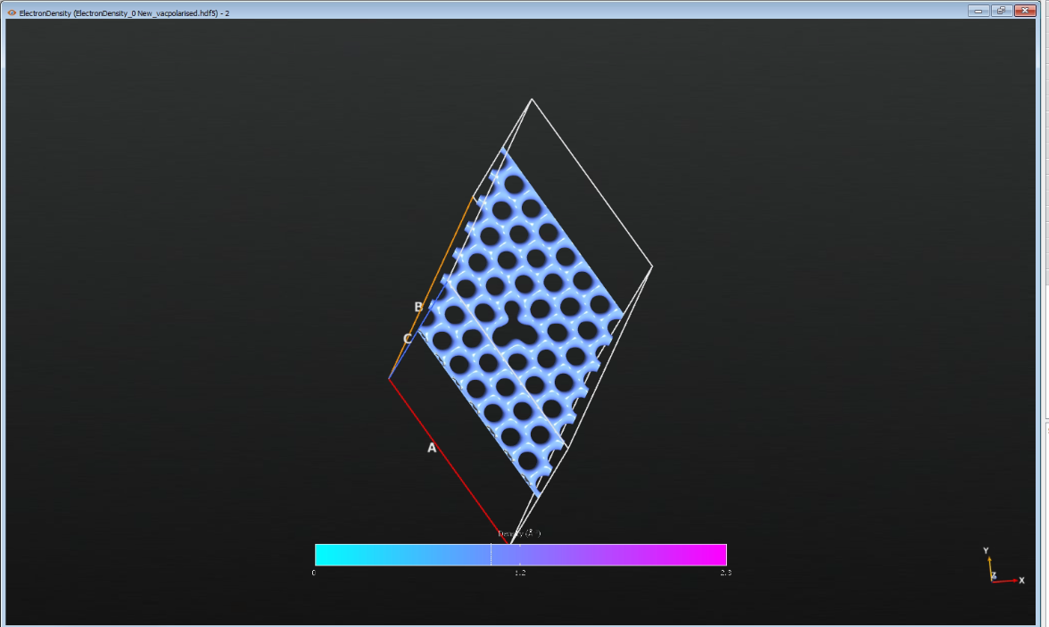
COMPARISION OF ELECTRON DENSITIES OF PRISTINE GRAPHENE AND GRAPHENE WITH VACANCY DEFECT
The graph above compares the electron density of pristine graphene and graphene with a vacancy defect.
The peak for pristine is higher than that of graphene with the vacancy defect.
Due to the defect the electron density gets disturbed around the region of the defect hence the graph.
The other figure shows the distribution of electrons at 1, which is constant throughout except the place where the vacancy is present.

Slide 14
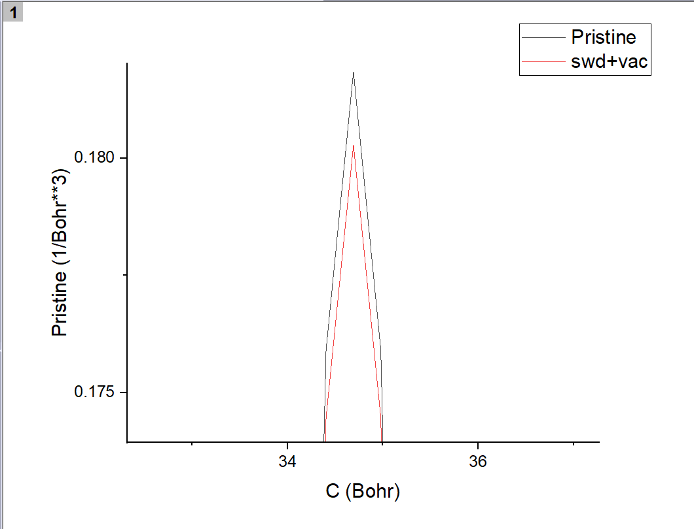
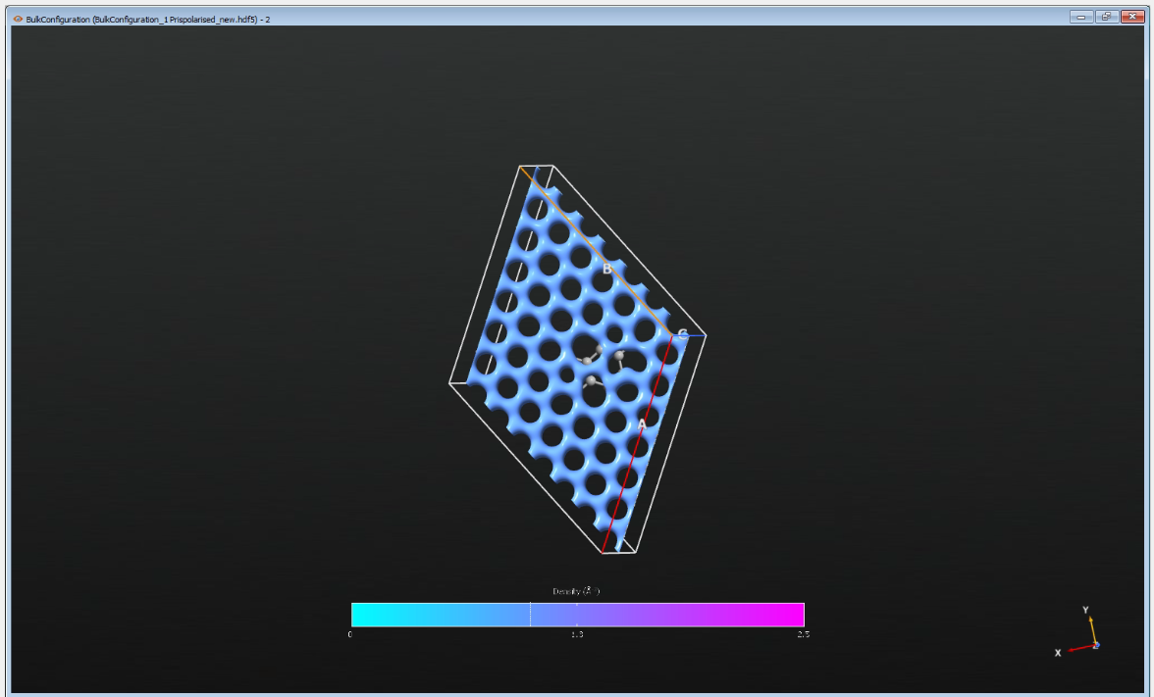
COMPARISION OF ELECTRON DENSITIES OF PRISTINE GRAPHENE AND GRAPHENE WITH VACANCY DEFECT AND STONE WALES DEFECT
The graph above compares the electron density of pristine graphene and graphene with a stone wales defect and carbon vacancy defect.
The peak for pristine is higher than that of graphene with the defects.
Due to the defect, the electron density gets disturbed around the region of the defect hence the graph.

Slide 15
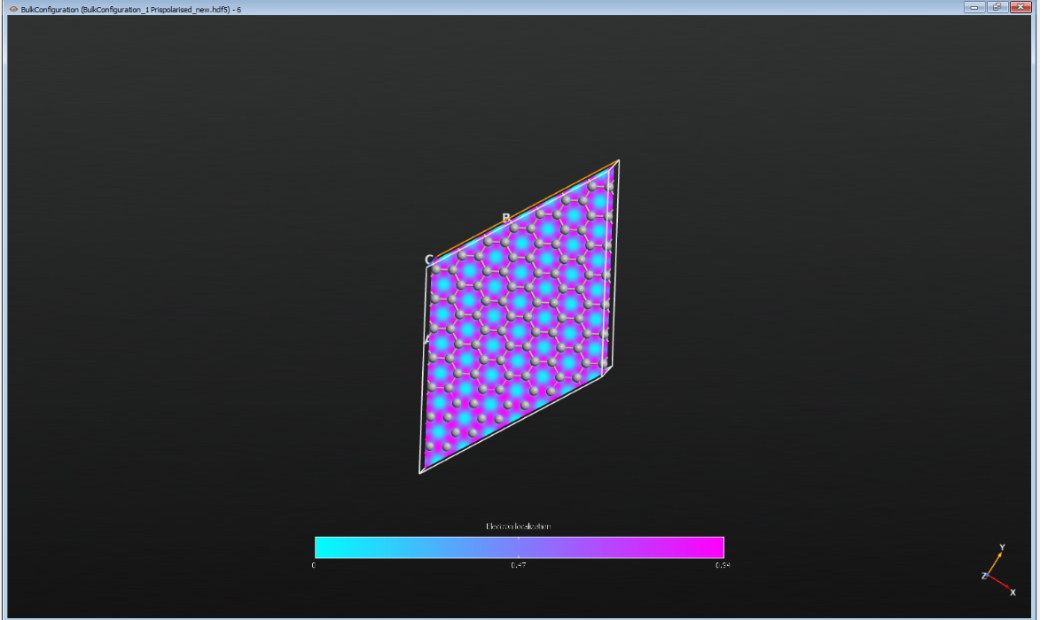
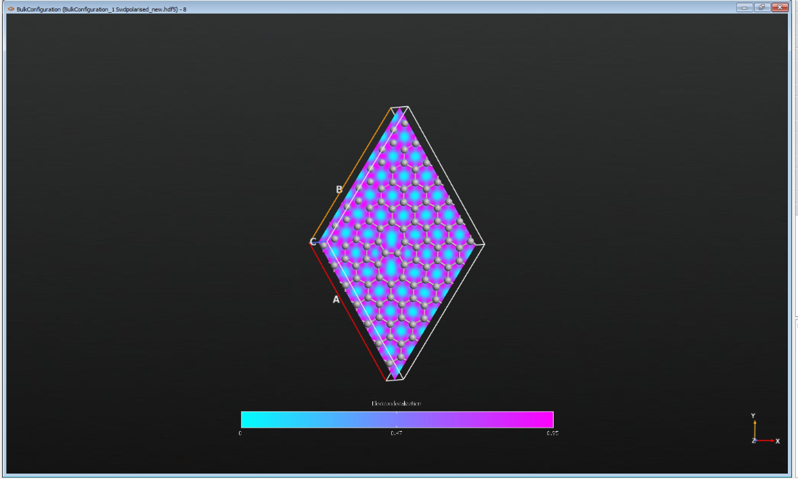
ELECTRON LOCALISATION FUNCTION FOR PRISTINE GRAPHENE AND GRAPHENE WITH STONE WALES DEFECT
The plots above show the localisation of electrons.
The more pink the region, the more localised the electrons are.
The electrons are more delocalised in the region where the defect is present.
We can say that because the area of the blue region is more in the place where the defect is present than in the rest of the places.

Slide 16
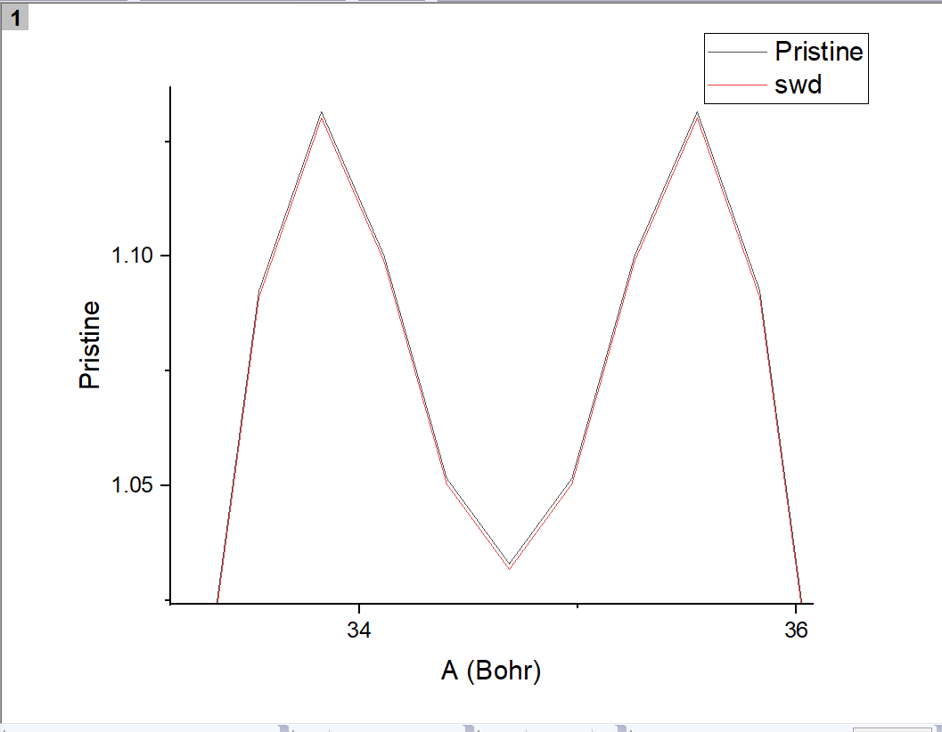
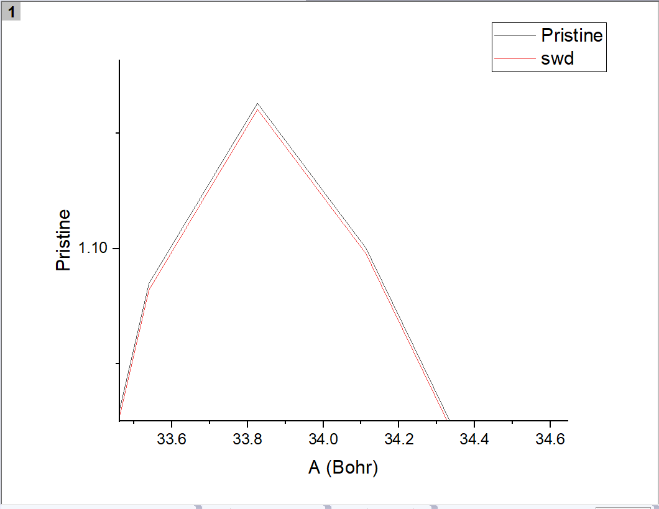
COMPARISION OF ELECTRON LOCALISATION FUNCTION OF PRISTINE GRAPHENE AND GRAPHENE WITH STONE WALES DEFECT
This is the plot of electron localisation function of pristine graphene and graphene with stone wales defect.
From the graph we can see that pristine graphene has a peak higher than that of graphene with a defect which shows electrons are more delocalised when defects are present.

Slide 17
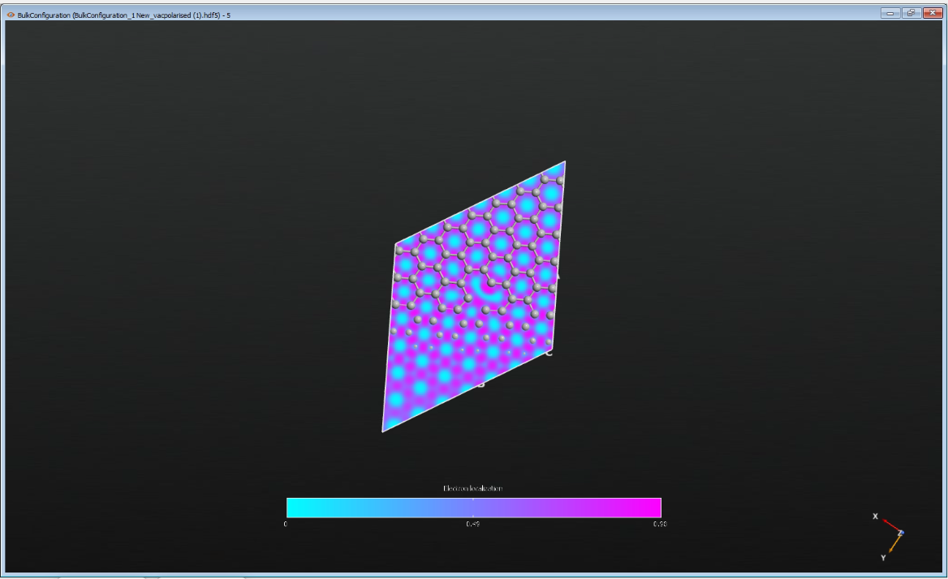
ELECTRON LOCALISATION FUNCTION FOR PRISTINE GRAPHENE AND GRAPHENE WITH VACANCY DEFECT
From the graph, We can see that at the sight of the vacancy defect there is a blue region which basically depicts that there is a delocalisation of electrons.
The blue region covers a greater area at the site of defect than that of the rest of the region signifying that the defect leads to delocalisation of electrons.

Slide 18
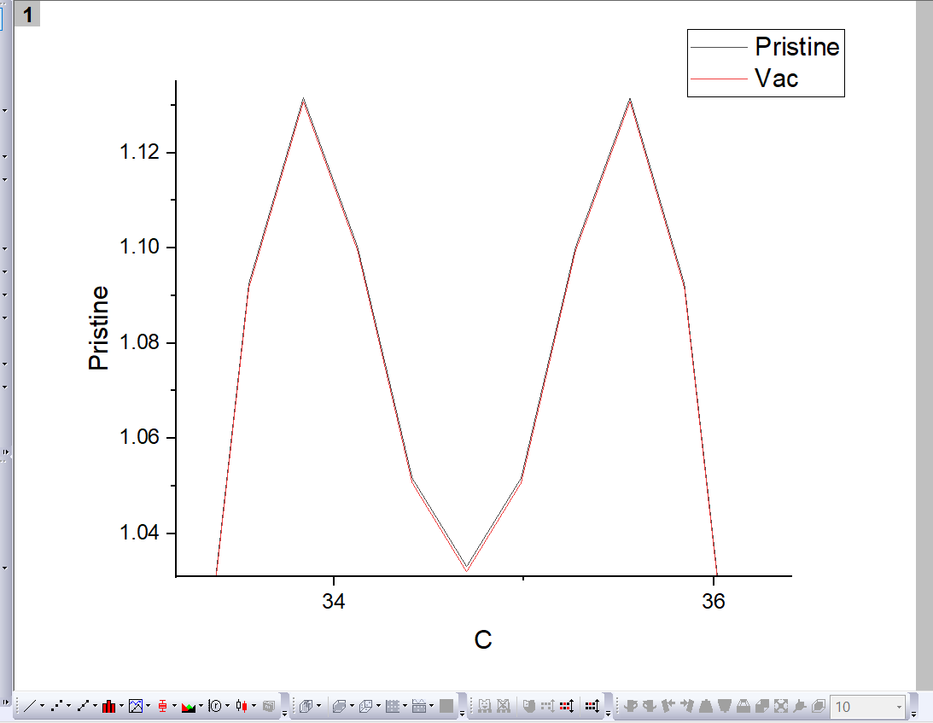
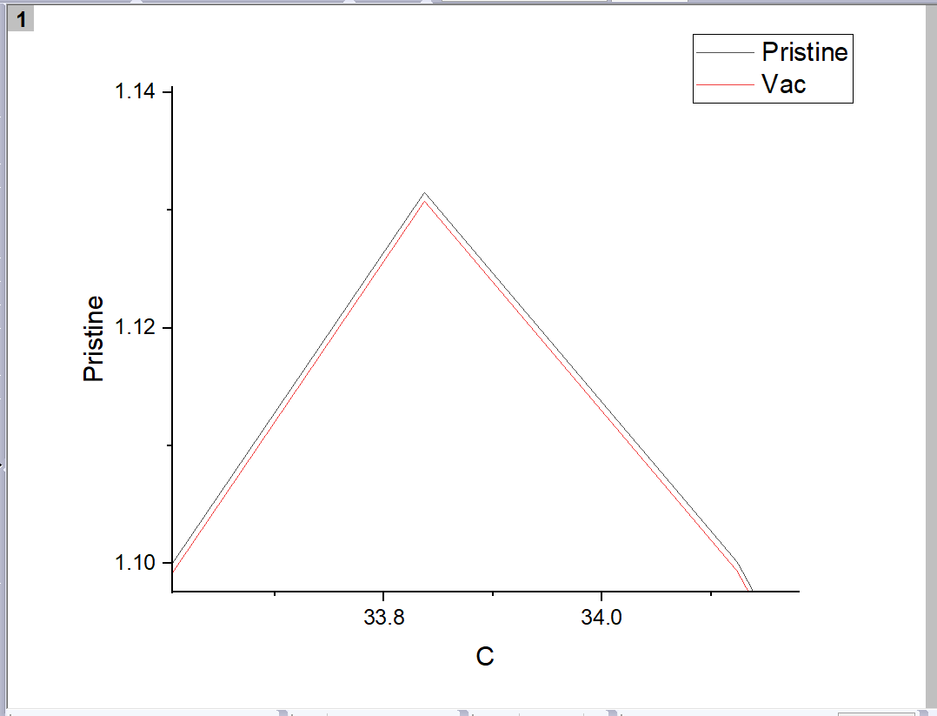
COMPARISION OF ELECTRON LOCALISATION FUNCTION OF PRISTINE GRAPHENE AND GRAPHENE WITH VACANCY DEFECT
This is the plot of electron localisation function of pristine graphene and graphene with vacancy defect.
From the graph we can see that pristine graphene has a peak higher than that of graphene with a defect which shows electrons are more delocalised when defects are present.

Slide 19
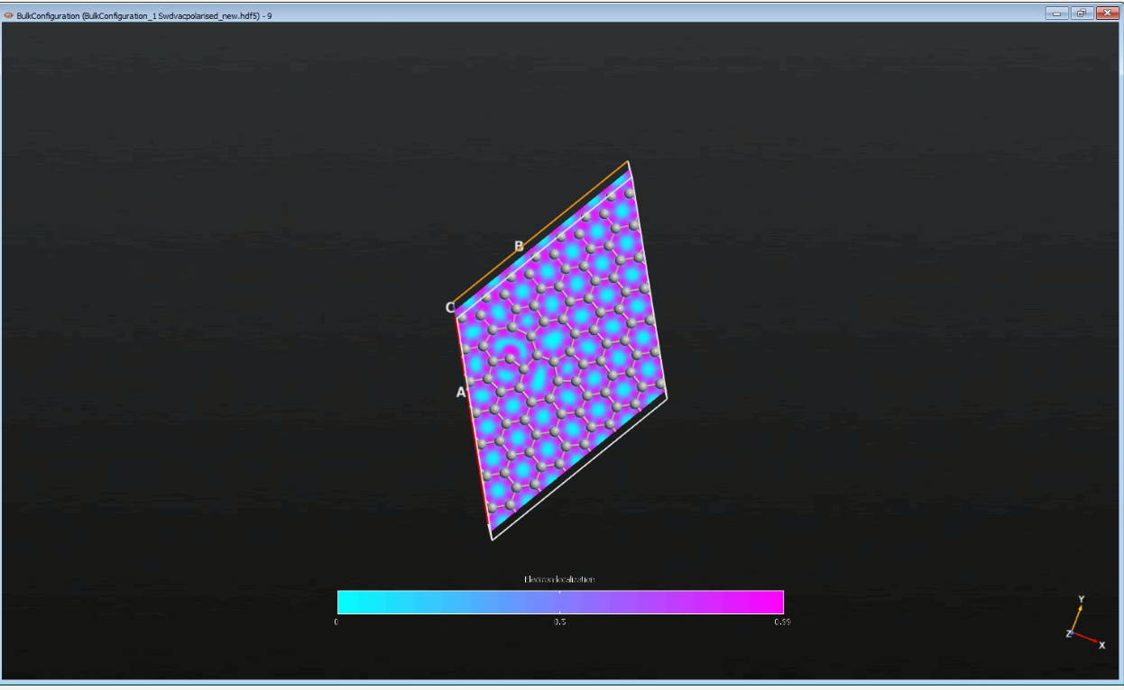
At the sight of defect there are more delocalised electrons than that of the other regions.
ELECTRON LOCALISATION FUNCTION FOR PRISTINE GRAPHENE AND GRAPHENE WITH STONE WALES AND VACANCY DEFECTS

Slide 20
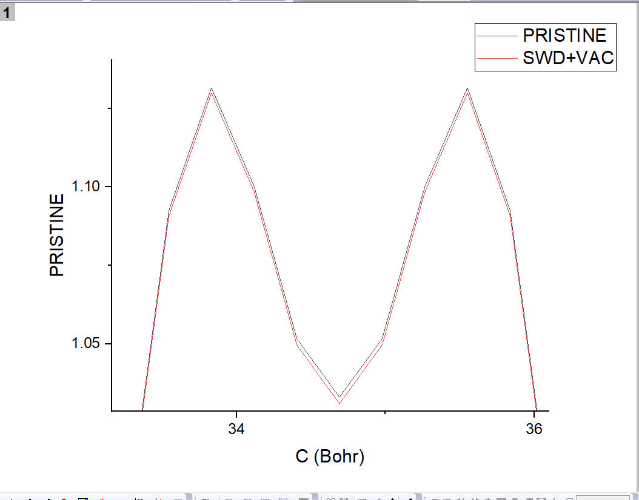
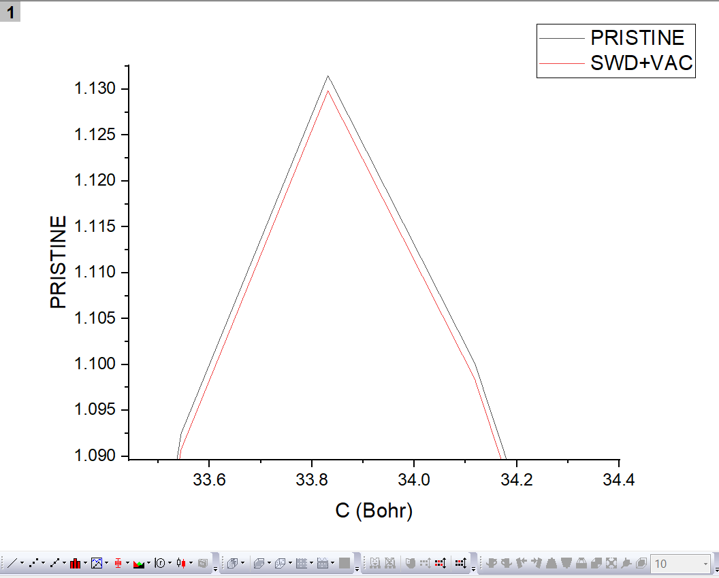
COMPARISION OF ELECTRON LOCALISATION FUNCTIONS OF PRISTINE GRAPHENE AND GRAPHENE WITH VACANCY DEFECT AND STONE WALES DEFECT
The graph depicts the electron localisation of pristine graphene and graphene with stone wales defect and vacancy defect.
The graph of pristine is slightly above than that of the graph of graphene with defect present in them, that is because defect brings in delocalisation of electron.

Slide 21
TABLE FOR TOTAL ENERGIES
Sr. No. | Type of Graphene | Total Energy
1. | Pristine Graphene | -16055.34872 eV
2. | Stone wales defect Graphene | -16050.32836 eV
3. | Vacancy defect Graphene | -15883.81291 eV
4. | Stone wales defect+ vacancy defect Graphene | -15881.28789 eV
These are the findings after the simulations were done which show that Pristine Graphene has the lowest energy followed by Graphene with stone wales defect, then the Graphene with a vacancy defect and finally the Graphene with both Stone wales and a carbon vacancy defect.
As we can see that Pristine Graphene has the lowest energy, which suggests that Graphene without any defect was more stable than Graphene which had defects in them.

